Slide 1
OneList Plus
Get listed and help your business get found online with OneList Plus.

Slide 2
Agenda
1
2
3
4
Importance Of Directory Listing
OneList Plus
Features & Benefits Overview
Addressing Common Concerns

Slide 3

Customers are searching online
Did you know that a staggering 63% of customer now make their purchases online?
In today's digital age, harnessing the power of online platforms is not just an option; it's an absolute necessity.
As per BrightLocal Survey 2023.
98%
of consumers used the internet to find information about local businesses in 2022.

Slide 4
Cost of neglecting directory listing
Lack of online visibility
Businesses risk being overshadowed by competitors that have optimized their online presence, resulting in decreased visibility and missed opportunities.
Inability to target mobile users effectively
Businesses miss out on local and mobile search traffic, reducing the chances of attracting customers who are actively searching for products or services in their area.
Reduced online credibility and trust
Businesses miss the opportunity to showcase positive customer feedback and testimonials, potentially undermining credibility and trustworthiness.
Negative impact on SEO
Neglecting online listing services may result in weaker SEO performance, making it harder for potential customers to discover the business through organic search.
Difficulty in tracking and measuring Without online listing, its challenging to gauge the impact of marketing initiatives accurately, hindering data-driven decision-making.
Limited access to online advertising opportunities
Online listing services often provide advertising options, such as sponsored listings or targeted ad placements.

Slide 5

Directory listing increase visibility and accessibility
93%
70%
81%
of local searches result in either a website visit or phone call.
Bright Local
of customers are more likely to visit and consider purchasing from businesses with a complete Business Profile.
Google Business
of customers conduct an online search before visiting a store.
GE Capital Retail Bank

Slide 6
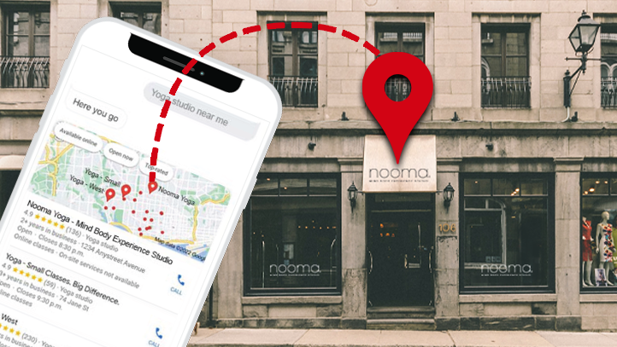
OneList Plus
Help your business get found online
One-time submission for up to 9-40+ directories
Improve your visibility and local SEO
Manage all business information from one place
Save time and money

Slide 7
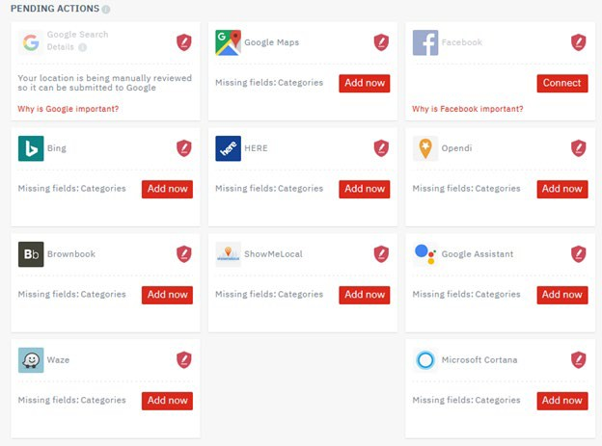
Get found online
OneList Plus syncs with major online directories, rating and review sites, navigation systems, apps and social networks. The directories included depends on your plan.
OneList Plus will also suppress any duplicate listings, which will help with SEO and ensure accuracy of your business information within search engines.
Once listed, OneList Plus locks your listing where applicable so third parties are not able to change your information.
Note: With Google Business Profile and Facebook®, you will need to allow OneList Plus to sync with your new or existing profiles by connecting them within your OneList Plus dashboard.

Slide 8
Look credible and established
OneList Plus lets you add keywords, descriptions, business category, your logo, images of your business, links to your social profiles and more to enhance your directory listings. Rich data will be published in any directories that support additional details about your business.

Slide 9
How it works

Slide 10
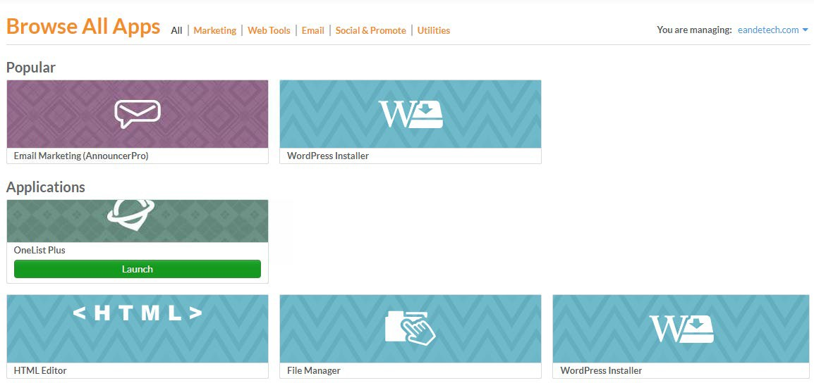
First step is to connect social and review accounts
Log in to your main dashboard and select Advanced Tools > Applications > OneList Plus to get started. This will launch your OneList Plus dashboard.

Slide 11
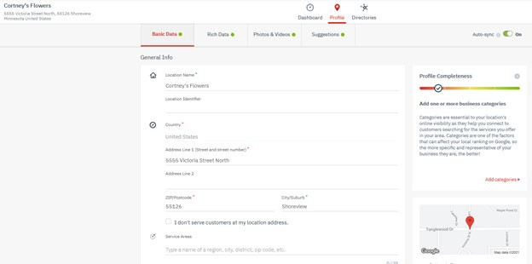
Setup a new profile in four easy steps
There are four sections:
Basic Data – Name, location, hours, keywords, etc.
Rich Data – Social media accounts, brands, language, services, etc.
Photos & Video – Add logo, images, and videos.
Suggestions – Once sync’d with the directories, other images or content might be found online. You will see profile suggestions appear and can choose to add or decline those items from your listing data. These suggestions are meant to enhance your profile.

Slide 12
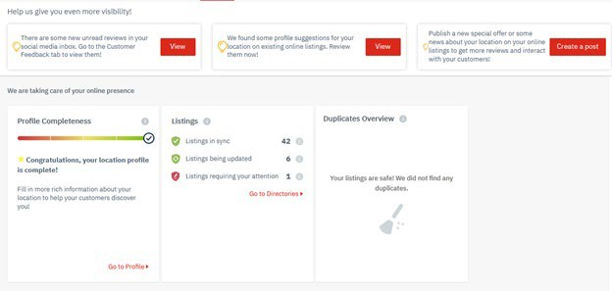
Dashboard that gives you the control over your directory listings profile
Customers can effortlessly access all of the features to enhance their online reputation and drive business growth. Say goodbye to the hassle of navigating multiple tools and platforms

Slide 13
Benefits
Easy-to-Use
Update your business information to many online directories with just one click
OneList Plus locks your business information. Scans happen daily to ensure your information is accurate and up-to-date.
Control your information
Cost effective
An inexpensive way to get in front of local customers at the right time. Your information gets published across many top online directories.
Getting listed in major online directories and having consistent name, address and phone information can improve your ranking in local search results.
Improve local SEO

Slide 14
Q & A / Next steps

Slide 15
Frequently Asked Questions

Slide 16
How does OneList Plus work?
OneList Plus has direct APIs or relationships with key online directories for instant or simplified listing submission. Your information is stored securely in our platform. Your company and location listings are automatically scanned daily and updated if required. Your listings are also protected against manipulation by third parties.
For certain directories or profiles that require accounts, OneList Plus requires you to provide authorization for access to your account to update the listing and ensure all your business details are consistent.
I do not have a website. Do I get any benefits from local listings at all?
Yes! You don’t need a domain or website in order to get your business listed and found online.
If you list your business now, it will show up in Google Maps and other directories. This is going to help customers find you and start building some online equity.
Once you have your website or domain ready, you can update your listing and it will get added to all of your directory listings.
My business already has listings in several directories. How does this affect my OneList Plus submission?
Before creating a location page in any directory, OneList Plus scan directories for existing entries. In general, OneList Plus seeks to avoid creating duplicates.
If a listing already exists for a location, there are two possibilities. The first is that OneList Plus is able to directly claim the listing. If it can be claimed, your profile is then blocked for manipulation by third persons.
The second possibility is that the listing is 'claimed by others'. This may occur if you previously worked with another provider to optimize your online presence and the existing profiles are still claimed by this service provider or agency. In this case, the business owner is required to personally contact the directory and request a transfer of ownership so that OneList Plus is able to claim the profile.
If you are engaged in an ongoing contract with another provider of online presence management services, this contract must first be terminated. If the contract has already been terminated and there is only a short remaining term, the directory may be asked to transfer protection rights to OneList Plus ahead of time.
Should all of these approaches fail, OneList Plus will attempt to delete the listing and recreate it. The listing will be immediately protected against manipulation by third parties.

Slide 17
Probing Questions

Slide 18
When customers search for the products or services you offer in your area, does your business show up?
Submitting your business information to online directories helps your business get found where potential customers are searching for businesses like yours. First, it helps improve your rank on search engines like Google, by providing backlinks to your website and providing more citations for search engines to verify your business information.
Secondly, online directories often show up on the first page of search results. Customers also use directories to search for businesses directly. You need to ensure your business is visible and accurate!
With OneList Plus, you submit your information in once place, and it automatically creates directory listings in essential maps, business databases, GPS systems and more.
Do you monitor your online listings?
Listings can change over time, overwritten by other search results and sometimes even by tampering. This can have a negative impact on your SEO. OneList Plus monitors, locks and protects your business info to ensure it stays accurate.
How many directories are you listed in? How do you update them? How often?
We have directory listing packages that can include 40+ directories. However, the number of directories will vary depending on which package has been purchased. Being able to manage, sync and update your business information in a single dashboard means you don’t have to keep track of different profiles and log in credentials, because all your listings are managed right through the OneList Plus dashboard. Turning on “auto-sync” within the dashboard will ensure the directories are scanned daily and all information is maintained for accuracy.
Is your business listed on Google Business Profile and in Google Maps?
Creating and verifying your Google Business Profile account is one of the best things you can do to help boost your local visibility! When potential customers search online or on Google Maps, you need to make sure your business can be found. It’s a critical first step because Google is the dominant search provider and has an overwhelming amount of search traffic, so you want to be setup where most customers start their searching.
Google Business Profile is included in our directory listing service, OneList Plus (applicable plans). You can connect your Google Business Profile account to make sure it shows consistent information with your other online listings, and you’ll get reporting on the impressions and clicks from your Google Business Profile.

Slide 19
Objection Handlers

Slide 20
I already have a lot of listings.
Which directories are you listed in? (Can check for the business listings on Google Maps or use the directory scan.)
Do you keep track of your listings? Are you sure all your listings have the same details and are still up to date? You can use our simple online visibility tool to do a quick scan on your business to determine where you are listed and if your profile data is incorrect.
It’s important to monitor your listings because information can change, false data tends to multiply online and your data is open for editing. OneList Plus monitors and resubmits your listings so everything stays accurate.
With OneList Plus, you get:
One-time, one-place submission across different directories
Daily data matching, if the data is correctly listed on directories
Directory listings don’t need ongoing management.
If your listings or NAP (name, address, phone) information aren’t monitored, they will change over time. The average business listing changes every 6 days just looking at name, address or phone: a total of 61 times per year.
Listings may pull from outdated info found across the Internet, so it’s important to monitor your listings to keep them accurate. Using a synced submission like OneList Plus also means the exact same details and formatting are submitted to every directory, which will help search engines like Google rank your business and website. OneList Plus locks your listings if possible and scans your listings daily fixing any issues with your information.
No website/Waiting to launch our website.
One great thing about online directories is you can start immediately; you don’t need a domain or website in order to get your business listed and found online.
If you don’t have a website then you definitely should sign up for listings now. Listings have a quick turn around so your customers can find and get to know your business while you are building the website.
If you list your business now, it will show up in Google Maps and other directories. This is going to help customers find you and start building some online equity.
Once you have your website or domain ready, we can update your listing and it will get added to all of your directory listings.
Can you guarantee that I will show up higher in the rankings?
Unfortunately, no one can guarantee this to you. The best way for you to potentially appear at the top of the search rankings is to invest heavily in PPC (Pay Per Click). Getting higher rankings and exposure online is costly and doesn’t always ensure that you will get ROI. This OLP offering is an affordable service that will get you listed in the top online directories that you are not listed in today. Maintaining these listings with good quality data will help increase your overall SEO value. Think of it this way, imagine if you had 1 person on the corner telling people who you are and where they can find you. Now imagine if you had 25 or 40 people doing this in a consistent manner. This means that you get in front of more people in more places. This is the power of OneList Plus.

Slide 21
Test Your Knowledge

Slide 22
Why are directory listings important for small businesses?
a) They help small businesses sell their products online
b) They provide discounts on advertising for small businesses
c) They improve the visibility and online presence of small businesses
d) They offer networking opportunities for small businesses
2. Which of the following is a consequence of not having a directory listing service for a small business?
a) Increased website traffic
b) Difficulty in reaching the target audience
c) Expanded product offerings
d) Enhanced customer loyalty
3. Why is accurate and up-to-date business information important in a directory listing?
a) It helps small businesses gain more social media followers
b) It ensures consistent branding across different directories
c) It allows small businesses to offer personalized discounts
d) It helps potential customers find and contact the business easily
4. What is the primary goal of a directory listing service for small businesses?
a) To sell products directly to consumers
b) To provide legal assistance to small businesses
c) To connect small businesses with potential partners
d) To increase online visibility and generate leads for small businesses
5. Which of the following is a potential consequence of not having a directory listing service?
a) Increased revenue and sales growth
b) Difficulty in reaching customers outside the local area
c) Streamlined customer service and support
d) Lower product quality and customer satisfaction
6. How does a directory listing service contribute to a small business's online visibility?
a) It improves the website's search engine optimization (SEO) ranking
b) It guarantees top placement in search engine results pages
c) It automatically generates online advertisements for the business
d) It provides access to a vast network of social media influencers
7. What can happen if a small business does not have a directory listing service in a competitive market?
a) The business may struggle to differentiate itself from competitors
b) The business may attract excessive attention from potential partners
c) The business may become ineligible for tax benefits and incentives
d) The business may have access to unlimited funding options
8. How can small businesses track the effectiveness of their directory listings?
a) By analyzing employee productivity and efficiency
b) By offering exclusive discounts and promotions
c) By monitoring website traffic and conversion rates
d) By conducting market research surveys
9. How can a directory listing service benefit small businesses in terms of cost-effectiveness?
a) By providing free advertising opportunities
b) By offering discounted office supplies
c) By automating customer service operations
d) By reducing employee salaries
10. What is a potential consequence for a small business without a directory listing service in terms of customer trust?
a) Increased positive word-of-mouth referrals
b) Difficulty in verifying the business's legitimacy
c) Enhanced customer loyalty
d) Improved customer satisfaction rates

Slide 23
Correct Answers
C
B
D
D
B
A
A
C
A
B

